Slide 1

عنوان درس: روش‌های رسمی در مهندسی نرم‌افزار (Formal Methods in Software Engineering) 1-1- مقدمه ای بر روشهای صوری
دكتر محمّد عبداللّهي اَزگُمي
دانشیار گروه نرم‌افزار
دانشكده مهندسي كامپيوتر
دانشگاه علم و صنعت ايران
azgomi@iust.ac.ir

Slide 2
فهرست مطالب
روش صوری چیست؟
مفاهیم روشهای صوری
توصیف صوری
اثبات صوری
وارسی مدل
تجرید
مزایا و معایب روشهای صوری
Reference: http://web.mit.edu/16.35/www/lecturenotes/FormalMethods.pdf

Slide 3
روش صوری چیست؟
چه روش صوری (formal method) می‌شناسید؟
از چه روش‌هایی تاکنون استفاده کرده‌اید؟
چه استفاده‌ای کرده‌اید؟
فایده استفاده از آن چه بوده؟
......

Slide 4
فرآيند توسعه نرم‌افزار: مدل آبشاری
System Engineering
استفاده از روش‌های صوری
Analysis
Design
Code
Testing
Classic “waterfall model” [Pressman 1996]
Maintenance
CDP
SPIN Tutorial - part I
4

Slide 5
Software Engineering and Formal Methods
Every Software engineering methodology is based on a recommended development process proceeding through several phases:
Analysis, Specification, Design, Coding, Unit Testing, Integration and System Testing, Maintenance
Formal methods can:
Be a foundation for describing complex systems
Be a foundation for reasoning about systems
Provide support for program development

Slide 6
What are Formal Methods?
FM is “techniques and tools based on mathematics and formal logic”
Can assume various forms and levels of rigor (سختي):

Slide 7
Formal Methods Concepts
Formal Methods
Formal Specifications
Formal Proofs
Model Checking
Abstraction

Slide 8
Formal Methods Concepts
Formal Methods
Formal Specifications
Formal Proofs
Model Checking
Abstraction

Slide 9
Formal Specifications
A formal software specification is a specification expressed in a language whose vocabulary, syntax and semantics are formally defined.

Slide 10
Formal Specifications
Translation of a non-mathematical description (diagrams, tables, English text) into a formal specification language
Concise description of high-level behavior and properties of a system
Well-defined language semantics support formal deduction about specification

Slide 11
Types of Specifications (1)
Informal
Free form, natural language
Ambiguity and lack of organization can lead to incompleteness, inconsistency, and misunderstandings
Formatted
Standardized Syntax (e.g. BNF)
Basic consistency and completeness checks
Imprecise semantics implies other sources of error may still be present

Slide 12
Types of Specifications (2)
Formal
Syntax and semantics rigorously defined
Precise form, perhaps mathematical
Eliminate imprecision and ambiguity
Provide basis for mathematically verifying equivalence between specification and implementation
May be hard to read without training

Slide 13


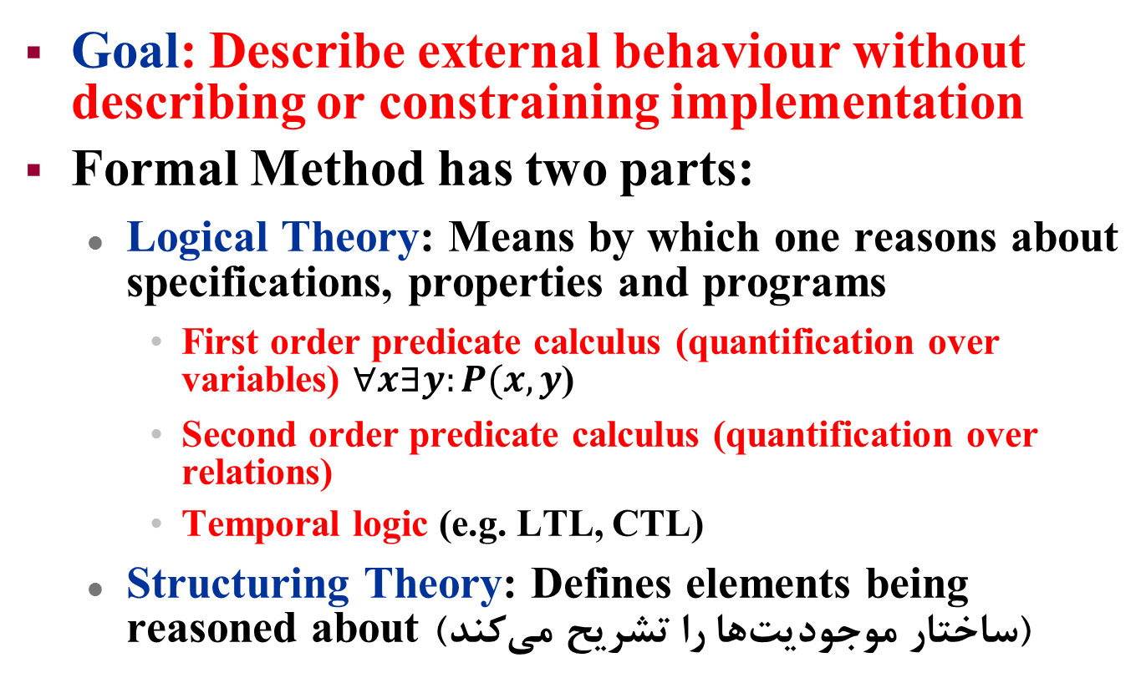
Formal Specifications
Goal: Describe external behaviour without describing or constraining implementation
Formal Method has two parts:
Logical Theory: Means by which one reasons about specifications, properties and programs
First order predicate calculus (quantification over variables) $∀x∃y:P(x, y$)
Second order predicate calculus (quantification over relations)
Temporal logic (e.g. LTL, CTL)
Structuring Theory: Defines elements being reasoned about (ساختار موجوديت‌ها را تشريح مي‌كند)

Slide 14
Example Problem: The English Specification
A space platform contains a number of instruments. Several communications channels are provided allowing both input and output instrument communications. Platform instruments may be placed in active or inactive states. Only active instruments may be assigned to I/O-channels. Active instruments may be assigned to more than one I/O-channel, up to some maximum number of I/O-channels per instrument. Further, I/O-channels may be shared by several active instruments, up to some maximum number of instruments shared per I/O-channel.
The objective is to construct a specification, that will manage the assignment of communication I/O-channels to spacecraft platform instruments.

Slide 15
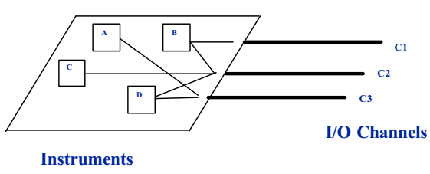
Example Assignments

Slide 16
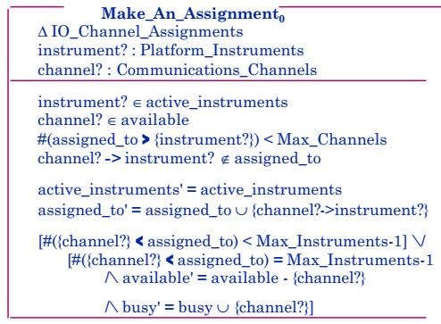
Completed Make_An_Assignment0 Schema

Slide 17
Formal Methods Concepts
Formal Methods
Formal Specifications
Formal Proofs
Model Checking
Abstraction

Slide 18
Formal Proofs
Complete and convincing argument for validity of some properties of the system description
Constructed as a series of steps, each of which is justified from a small set of rules
Eliminates ambiguity and subjectivity inherent when drawing informal conclusions
May be manual but usually constructed with automated assistance

Slide 19
Formal Methods Concepts
Formal Methods
Formal Specifications
Formal Proofs
Model Checking
Abstraction

Slide 20
Model Checking
Model checking is a method for formally verifying finite-state concurrent systems.
Specifications about the system are expressed as temporal logic formulas, and efficient symbolic algorithms are used to traverse the model defined by the system and check if the specification holds or not.

Slide 21
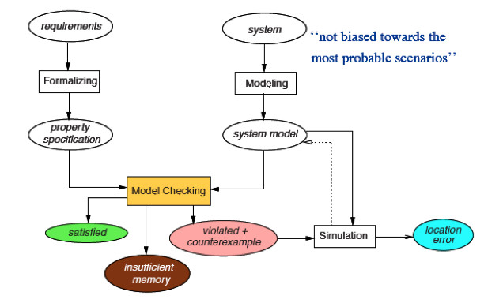
Model Checking

Slide 22
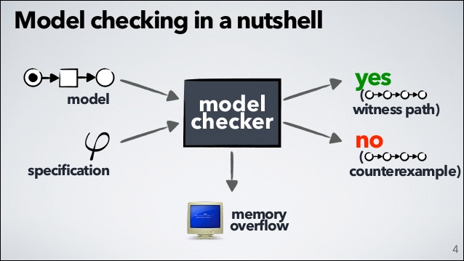
Model Checking

Slide 23
Formal Methods Concepts
Formal Methods
Formal Specifications
Formal Proofs
Model Checking
Abstraction

Slide 24
Abstraction
Simplify and ignore irrelevant details
Focus on and generalize important central properties and characteristics

Slide 25
Benefits of Formal Specifications
Higher level of rigor enables a better understanding of the problem
Defects are uncovered that would likely go unnoticed with traditional specification methods
Identify defects earlier in life cycle
Can guarantee the absence of certain defects

Slide 26
Benefits of Formal Specifications (cont’d)
Formal specifications enable formal proofs which can establish fundamental system properties and invariants
Encourages an abstract view of system -- focusing on what a proposed system should accomplish as opposed to how to accomplish it
Abstract formal view helps separate specification from design

Slide 27
Limitations of Formal Methods
Used as an adjunct to, not a replacement for, standard quality assurance methods
Formal methods are not a panacea(نوش‌دارو), but can increase confidence in a product’s reliability if applied with care and skill
Very useful for consistency checks, but can not assure completeness of a specification

